Slide 1
1. RMA Processing time
•Time table
1. 2021.12.23 Ship out from Korea.
2. 2021.12.30 HK warehouse arrived.
3. 2022.01.26 VN factory arrived.
4. 2022.03.08 RMA report to ALT
5. 2022.03.28 VN factory ship out to Korea
6. 2022.04.04 ALT is received RMA box.
•It was delayed by more than a month from the time specified by the FII
Fii feedback
This is the first time we do RMA process, we will have more action to reduce time for next time

Slide 2
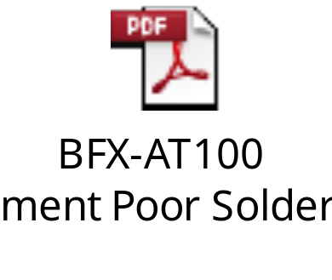
2. Product status
Foot rubber missing
We have already shipped the foot rubber again to ALT.
Next time we will remark to SOP for Ops paste them
2. Label -Assembled in Vietnam
As meeting discussed, we will update SOP and paste that label on foot rubber
3.Soldering quality
Please see the file attachment
4.Latest SW update
After repair F/W will be updated current mass production v532.20(2021.11)

Slide 3
3. Document update
HK address
BANG TAI INTERNATIONAL LOGISTICS CO., LTD.
DD118, LOT 1120 RP Yau Cha Po Village, Tai Shu Ha West Road, Yuen Long, N.T., HongKong
Cathy Liu
Customer Service and Operation
Fax : 3753 5774
Mobile 6306 1117
Direct 852-39749185
cathyliu@bangtailogistics.com/CNSBG@bangtailogistics.com

